Slide 1

NIPIN ESD Protection Diode
Project Course - Prof. Sandip Lashkare
By: Krish Patel

Slide 2
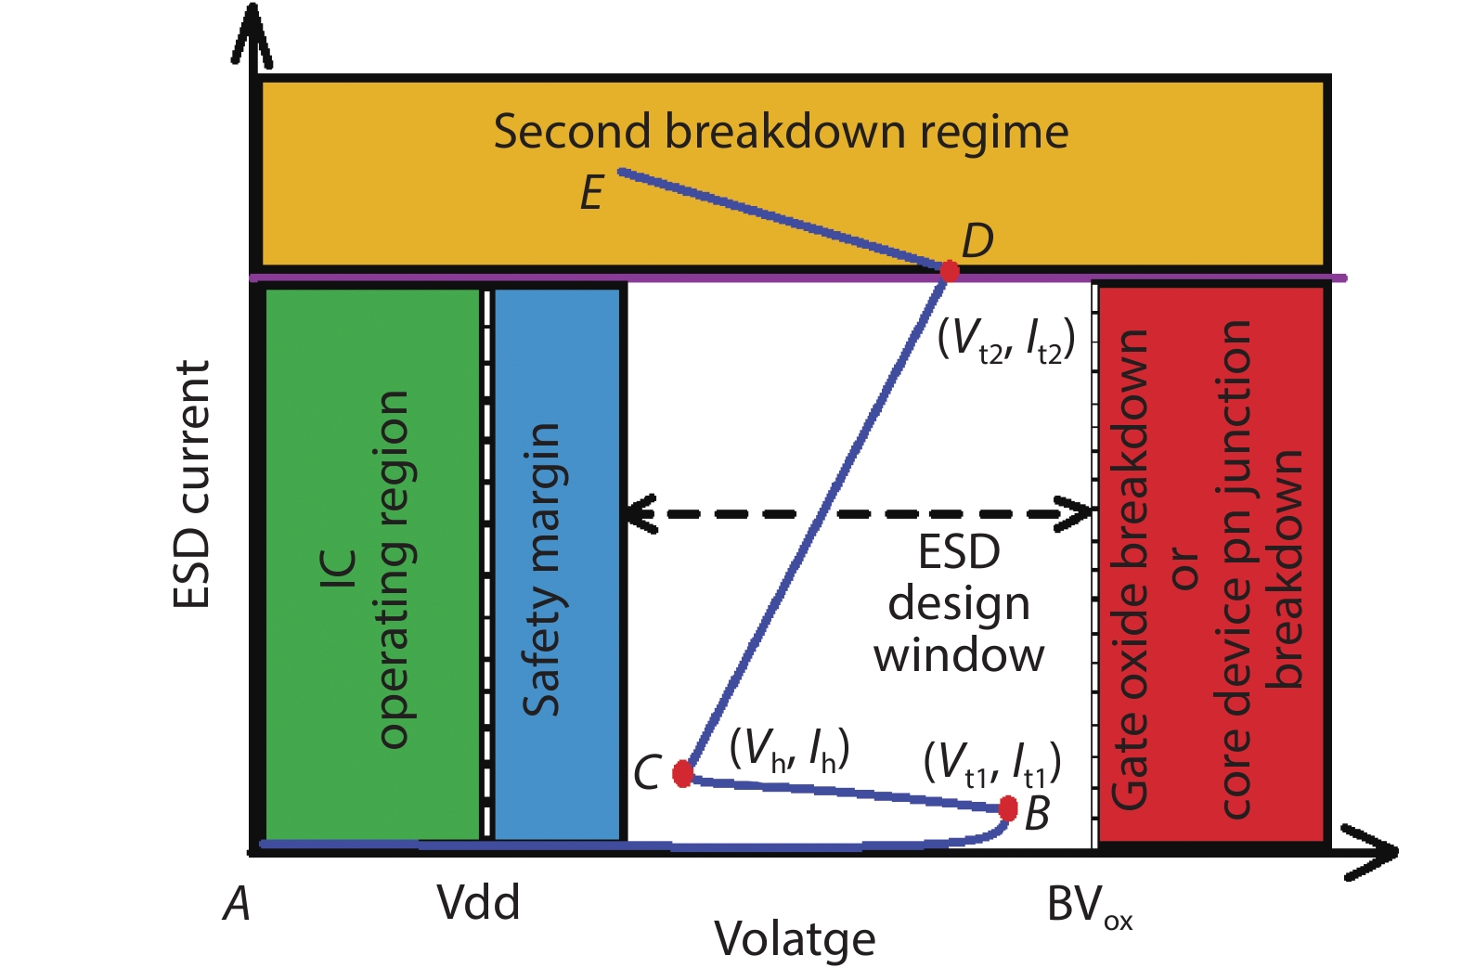
ESD Protection Window
Green: IC Operating
Normal voltage range where IC operates safely
Blue: Safety Margin
Buffer zone before protection device triggers
White: ESD Protection Zone
Voltage range where protection device must clamp safely
Red: Failure Zone
Breakdown of gate oxide or core junction — fatal
Yellow: Second Breakdown
Dangerous regime after the ESD device itself fails

Slide 3

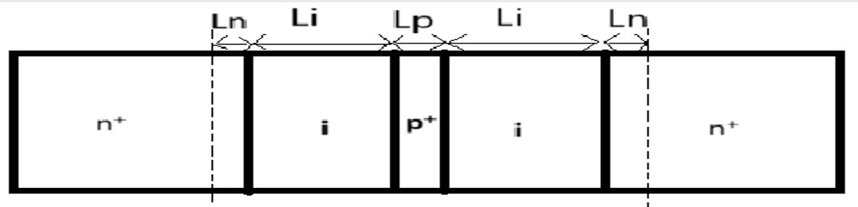
Device Structure and Concept?
The NIPIN punch-through diode consists of n+-i-p+-i-n+ layers, where the thin p+ region (2-7nm) between two intrinsic (i) regions creates a triangular potential barrier. This design enables punch-through breakdown at ultra-low voltages (<0.5V) and bi-directional operation, making it ideal for ESD protection.
Device Structure

Slide 4
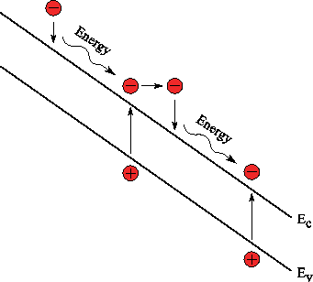
How is the Breakdown Voltage Reduced to <0.5V ?
In case of a normal diode, impact ionization occurs when a high-energy electron collides with atoms in the crystal lattice, knocking free additional electron-hole pairs. This usually requires energy equal to or greater than the bandgap energy (Eg) of the material (e.g., >1.1 eV for silicon).
However in the case of NIPIN diode, happens sub-bandgap impact ionization
, electrons with less than the bandgap energy still cause ionization. This happens due to:
High electric fields in the ultra-thin region p+ layer .
Hot electrons from the tail of the Boltzmann energy distribution having enough energy to trigger ionization, even at voltages below Eg.

Slide 5

How is the Capacitance Reduced ?
Intrinsic layers act as spacers, increasing depletion width
Punch-through effect modifies charge distribution(Distributed Charge)
Low doping in the i-region further increases depletion width
Lower parasitic capacitance makes it ideal for high-speed circuits
NIPIN diode is intended for low-voltage, high-speed applications such as USB 3.0, HDMI, Thunderbolt, and RF circuits due to its low capacitance and fast response time

Slide 6
Electrostatics Of NIPIN Diode
.

Slide 7
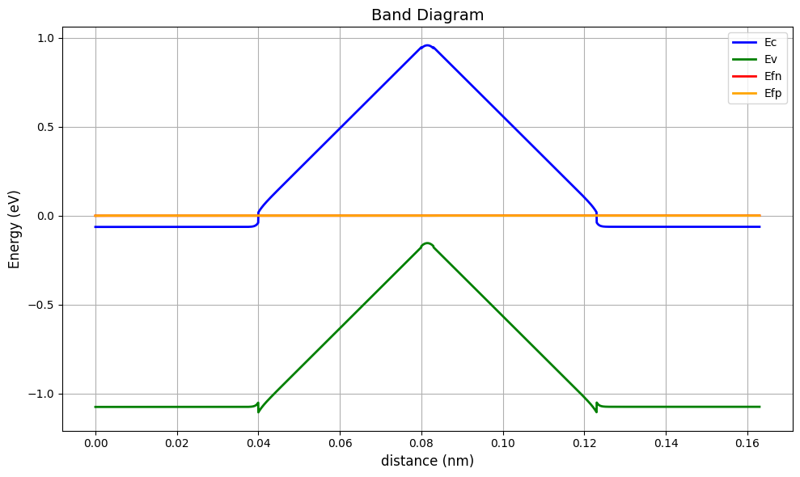
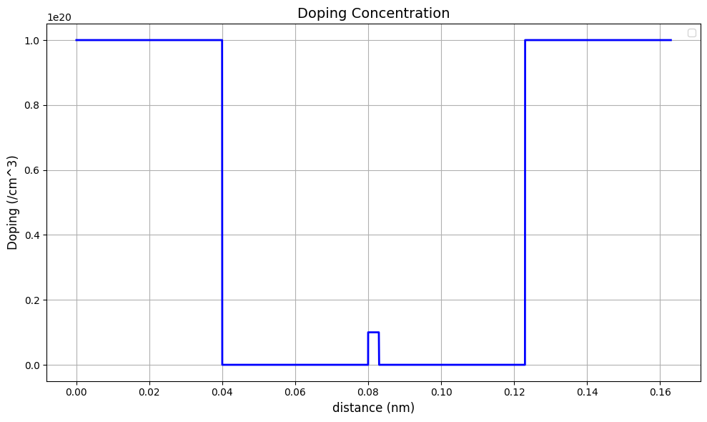
Band Diagram
The band diagram of the NIPIN diode has a shape of triangular barrier region.
Value of V_{b0} = 0.32 V, due to this low value of V_{b0} this diode can be used for low voltage application.
Through the plot we observe due to the presence of intrinsic region the length of depletion width increases.

Slide 8
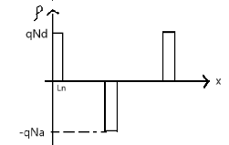
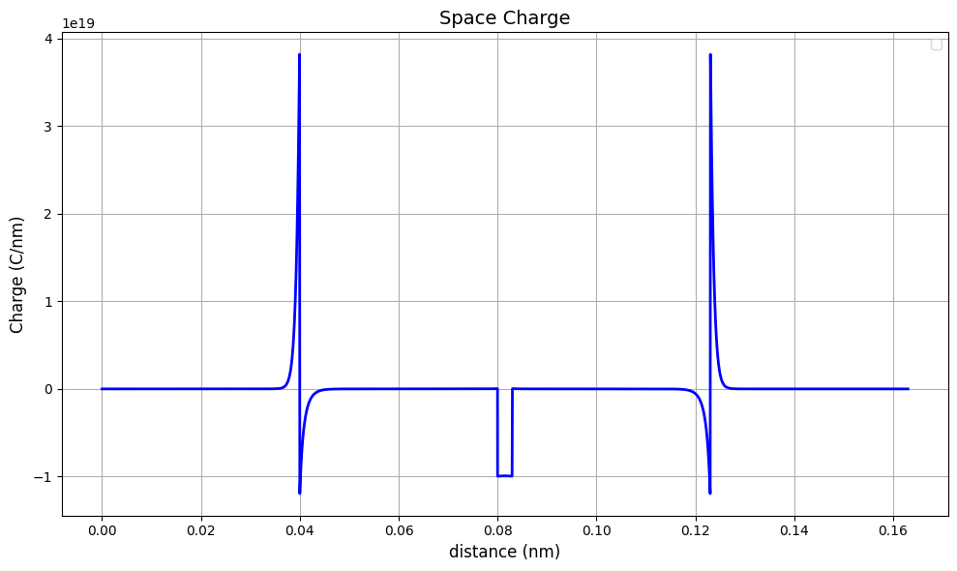
Charge Profile
From the Charge profile Diagram we can say that:
qN_{d}L_{n} + qN_{d}L_{n} = qN_{a}L_{p}
2*N_{d}L_{n} = N_{a}L_{p}
The charge profile shows the similarity with the one derived theoretically.

Slide 9
Depletion Region and Punch Through
From the charge profile we can observe the presence of the depletion region, in the p region and on the edge of I and N region.
The diode goes through the punch through which we can observe through the complete depletion of I and P region.

Slide 10
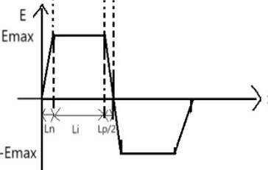
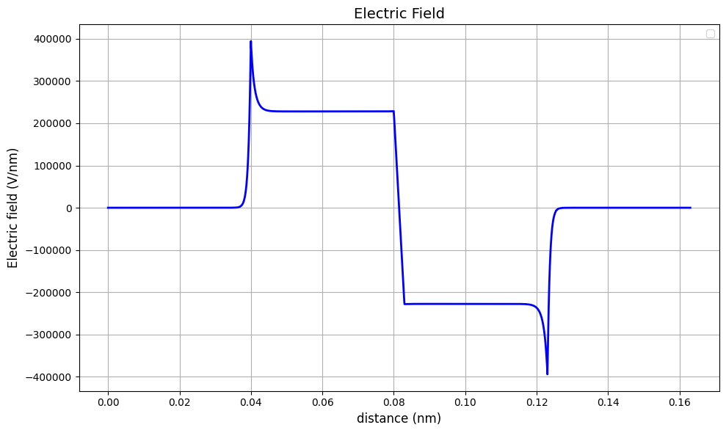
Electric Field
Through, charge profile we can derive the electric field profile:
E_max = 1/ε q N_{d} L_{n}= (qN_{a} L_{p})/2ε
The Electric field profile of the Nipin diode shows similarity with the theoretically plotted graph.
Here the p region is under full depletion due to which there is a continuous drop in the value.

Slide 11
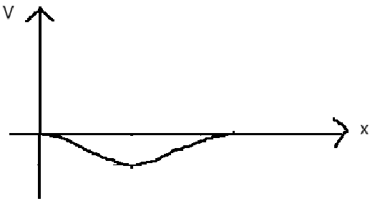
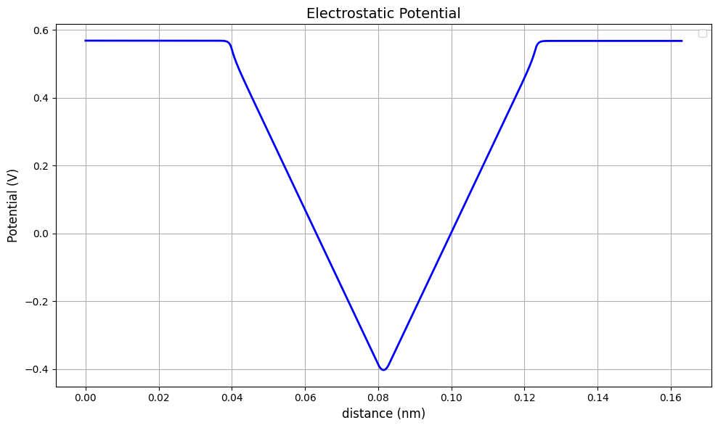
Electric Potential
The plot shows a symmetric potential drop in the middle, with a potential barrier V_{b0}.
Therefore, the value of 𝑉_{𝑏0} is equal to the are under the first trapezium in electric field profile.
𝑉_{𝑏0} = 1/2[𝐿_{𝑛}+𝐿_{𝑖}+𝐿_{𝑝}/2+𝐿_{𝑖}]𝐸_{𝑚𝑎𝑥}
= (𝑞𝑁_{𝑑} 𝐿_{𝑛}²)/2𝜀 + (𝑞𝑁_{𝑎} 𝐿_{𝑖} 𝐿_{p})/2𝜀 + (𝑞𝐿_{𝑝}² 𝑁_{𝑎})/8𝜀
Since, 𝐿_{𝑛} and 𝐿_{𝑝} have low magnitude so there square value will be negligible.
𝑉_{𝑏0} =(𝒒𝑵_{𝒂} 𝑳_{𝒊} 𝑳_{𝒑})/𝟐𝜺

Slide 12
Plots Analysis

Slide 13
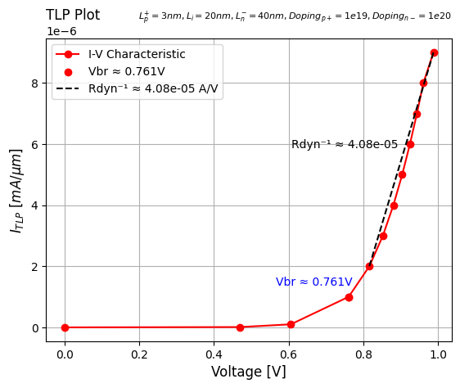
TLP Plot of Standard Values
Rdyn is the Resistance experienced by the shunted current , Lesser Rdyn indicates Better Protection as More Current is shunted resulting in lesser current flow to the DUP
Clamping Voltage (Vₛ) is the maximum voltage a Transient Voltage Suppression (TVS) diode or ESD protection device allows across a circuit before it starts conducting heavily to divert excess transient energy

Slide 14
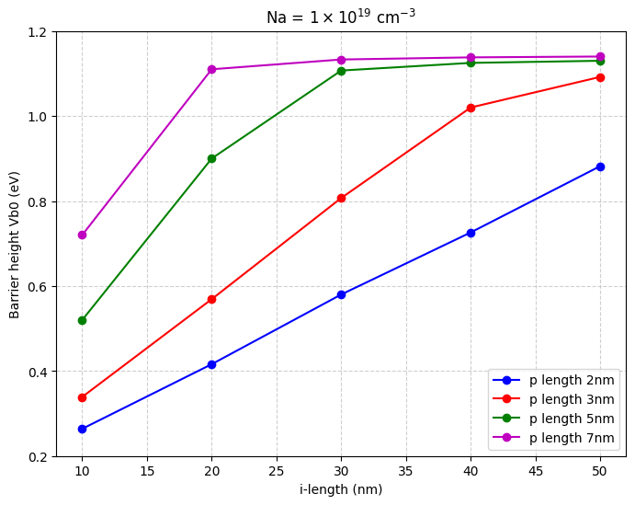
V_{b0}with L_{p}and N_{a} variance
Formula for V_{b0}=
qN_{a}L_{i}L_{p}/2ε
We can observe that the value of V_{b0}as we increase the value of L_{i} since it is proportional to V_{b0}.
The value of V_{b0} increase linearly initial for all value of L_{p} but it begins to saturate for higher values of L_{p}.

Slide 15
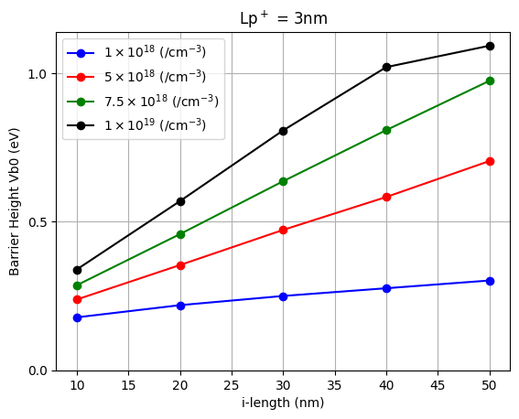
V_{b0} with N_{a} and L_{i} variance
Formula for V_{b0}= qN_{a}L_{i}L_{p}/2ε
We can observe that the value of V_{b0} as we increase the value of Li since it is proportional to V_{b0}.
It shows that the value of V_{b0} is directly proportional to N_{a}, L_{i} and L_{p}.

Slide 16
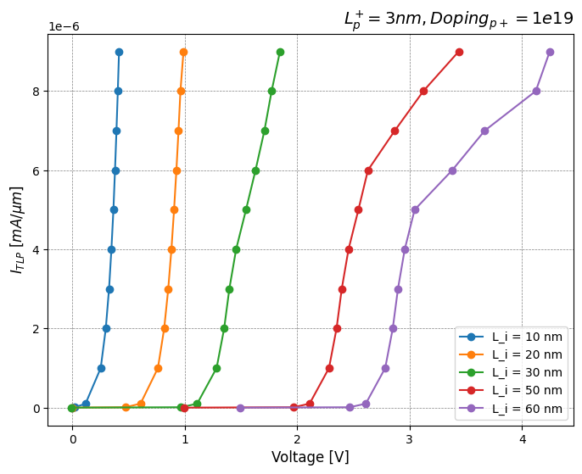
Lᵢ Variation
As L_{i} increases Barrier Height Increases due to which the V_{br} of the diode increases
With a very long i-region (>50nm), the voltage needed for breakdown increases significantly.

Slide 17
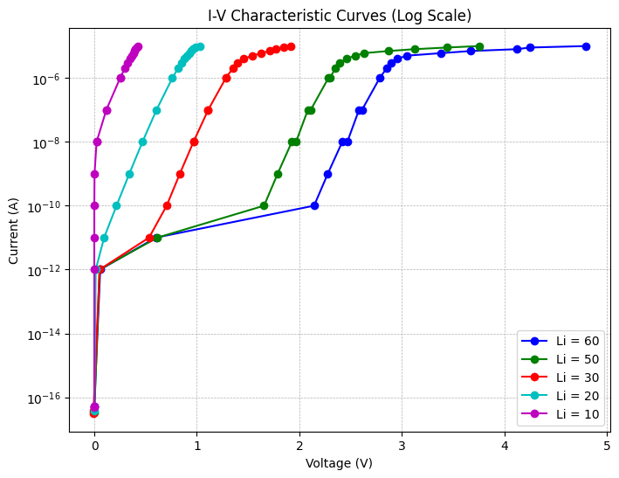
Semilog Scale
A shorter i-region reduces the depletion region size, making it easier for electrons to tunnel through.
This increases leakage current, which is undesirable in ESD protection.

Slide 18
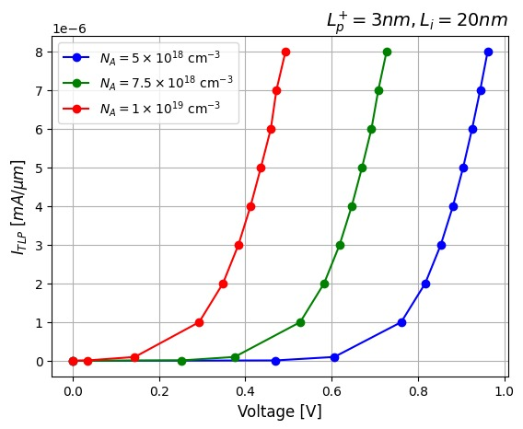
Nₐ Variation
If p+ doping is low, the barrier height is low, allowing more electrons to tunnel through thus a Low V_{br} also it results in more leakage current.
Increasing p+ doping concentration increases breakdown voltage.
Inference: A high enough p+ doping (≈10¹⁹ cm⁻³) is needed to maintain a strong barrier while preventing excessive leakage.

Slide 19
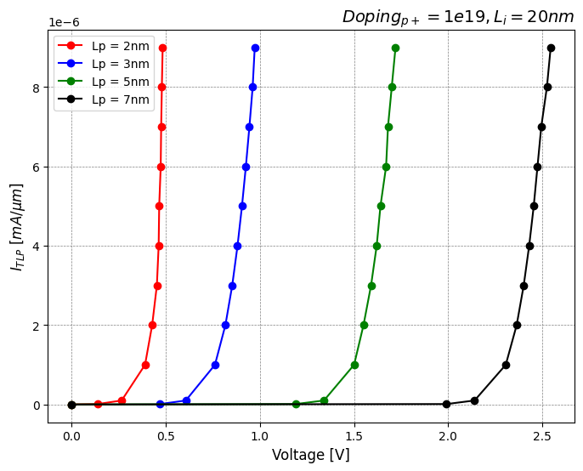
Lₚ⁺ Variation
Increasing Lₚ⁺ increases the barrier height due to which the Vbr increases,
A shorter p+ region creates a sharper, triangular potential barrier, which helps with impact ionization at low voltages.
However, too high Lₚ⁺ flattens the triangular barrier, making the impact ionisation less effective even though it increases Breakdown Voltage.

Slide 20
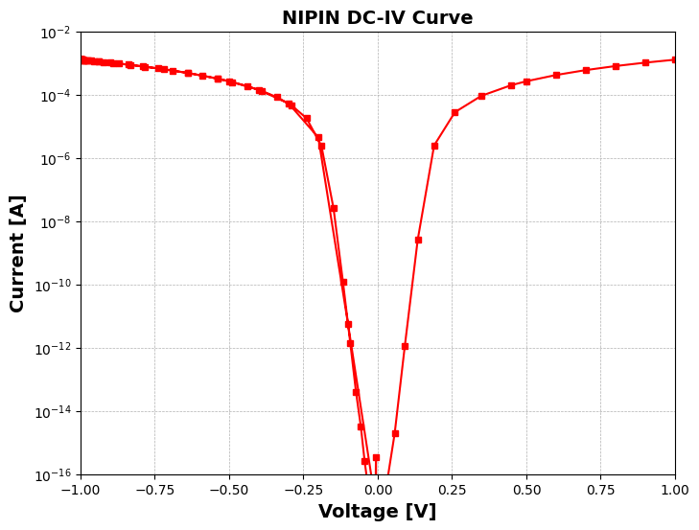
DC IV Curve
The NIPIN DC-IV curve shows a sharp drop in current near 0V because the middle Intrinsic (I) layer creates a wide depletion region, restricting charge carrier movement. This depletion region causes very low current flow at small voltages
As voltage increases, the current rises since charges get enough energy to move.
The curve is symmetric because the structure is balanced on both sides.

Slide 21
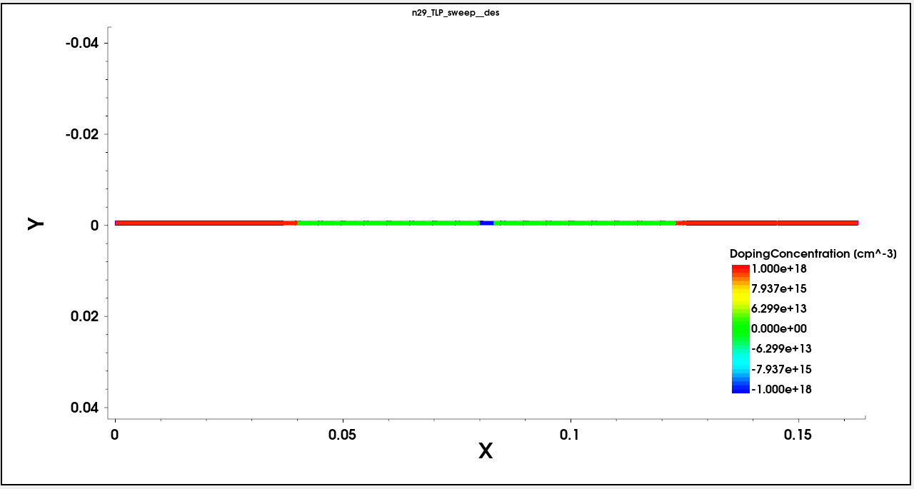
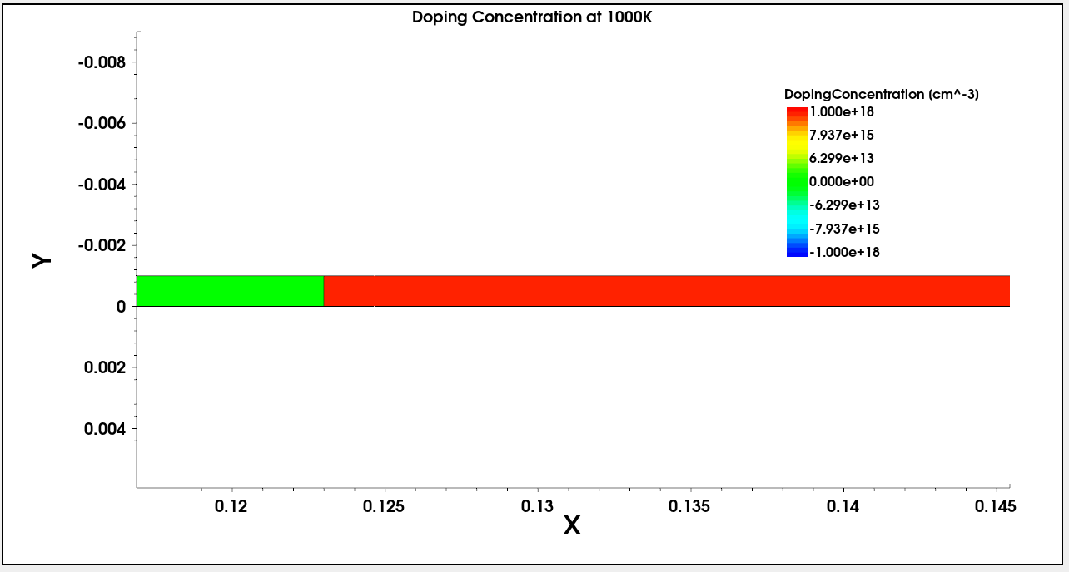
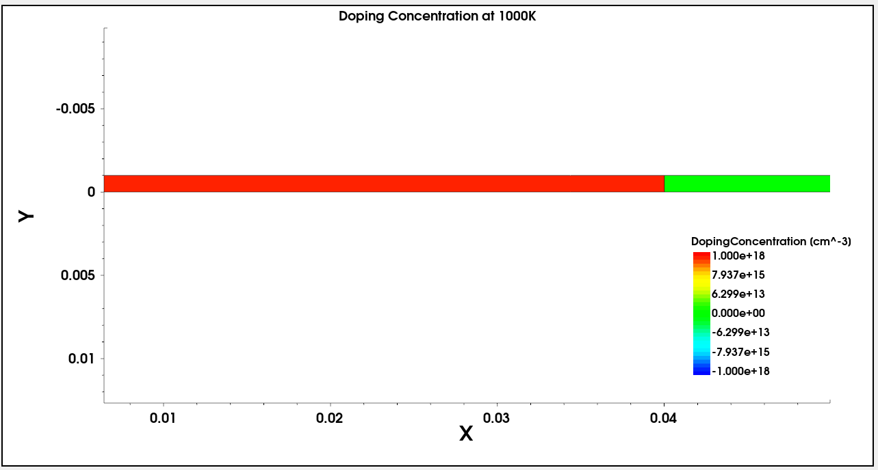
Doping Conc. @1000K
The red regions at both ends indicate highly doped n-type regions, ensuring strong conductivity with abundant charge carriers.
The green region in the middle represents intrinsic Layers or lightly doped area.
The doping profile is symmetrical, indicating a well-balanced structure, which helps in maintaining uniform electric field distribution
Doping in Right Corner
Doping in left corner

Slide 22
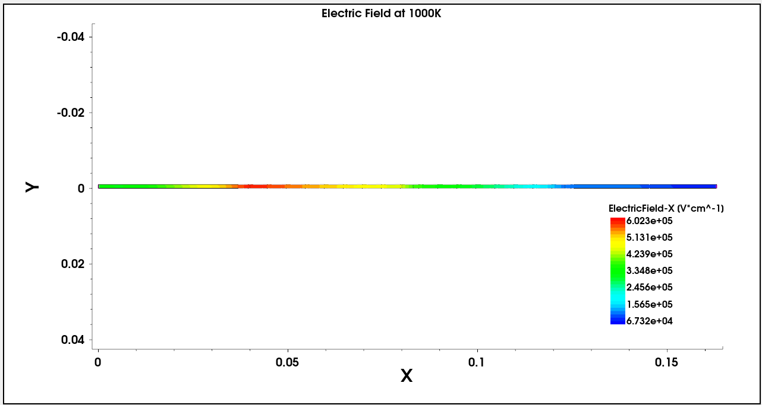
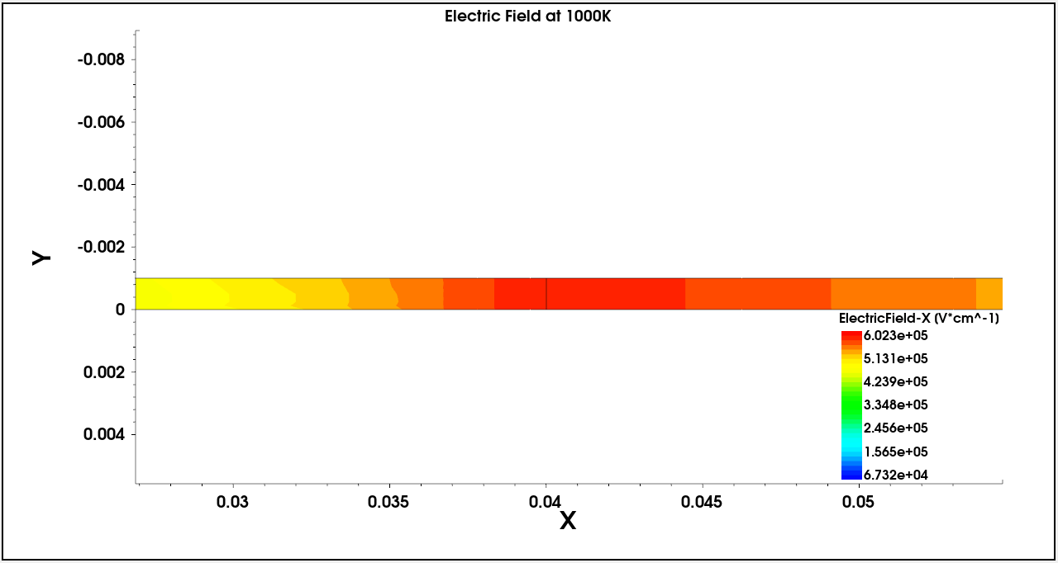
Electric Field @ 1000K
The electric field strength decreases as X increases, meaning the force acting on charge carriers weakens over distance.
The strongest field appears in a small hotspot near the center, likely at the junctions, where charge separation is most intense, aiding fast carrier movement.
At the edge of N-I, the electric field is strong because of the depletion region due to bond charges.
As we go towards P region the potential value decreases.

Slide 23
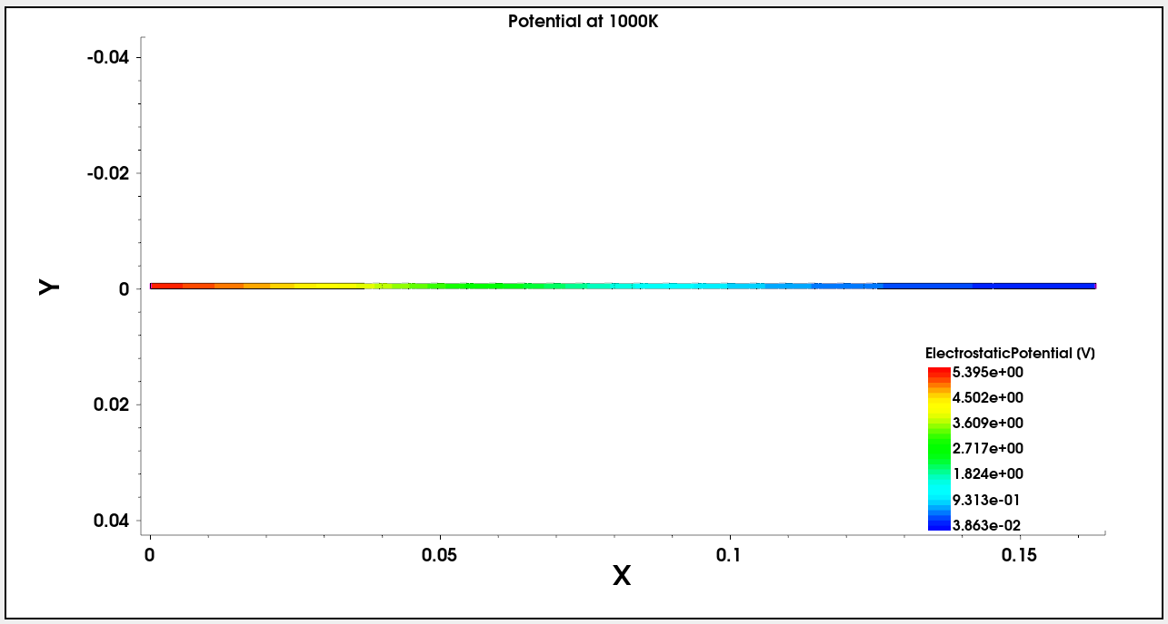
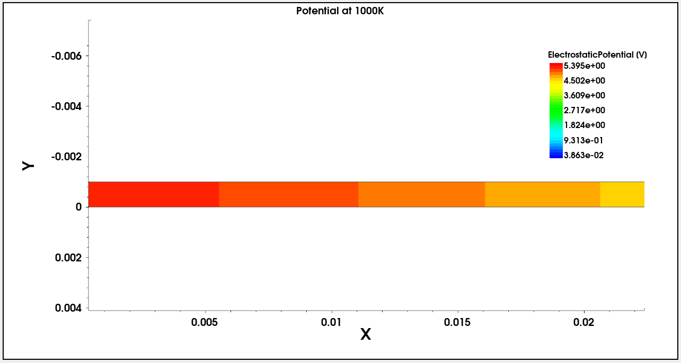
Potential @1000K
The gradual transition from high potential (red) to low potential (blue) indicates a well-defined built-in electric field,
The central region (green) corresponds to the intrinsic (i) layer, where the potential is more evenly distributed, ensuring minimal carrier recombination

Slide 24
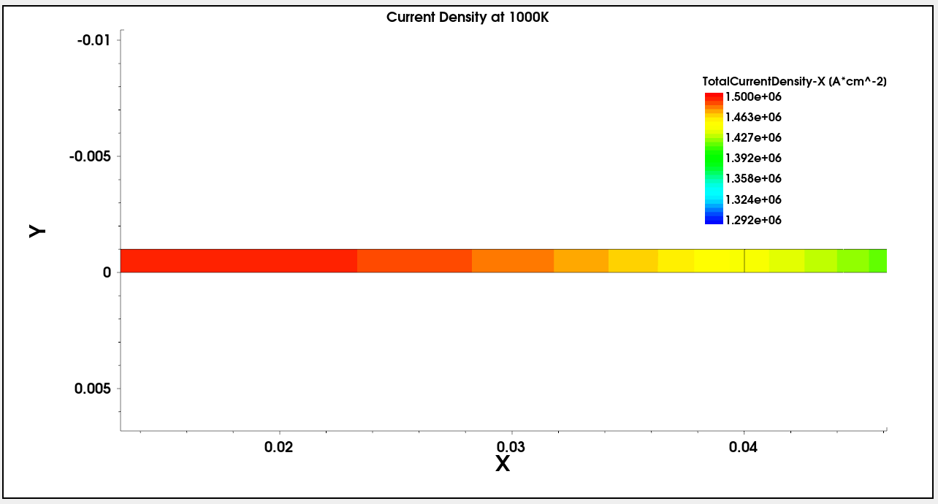
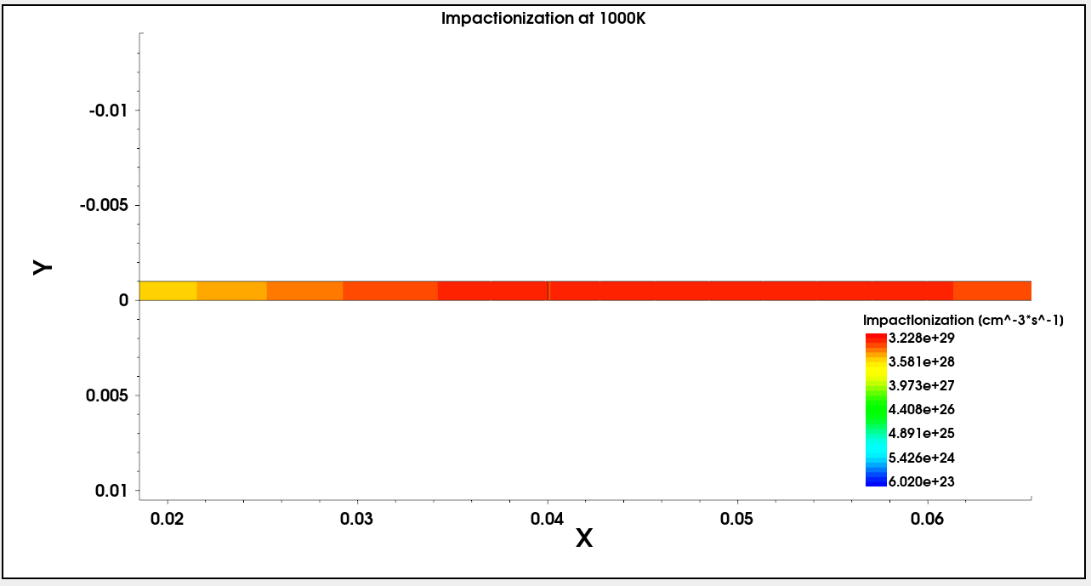
Is Current Density High Where Impact Ionization is High?
Impact ionization generates additional electron-hole pairs, increasing the carrier concentration (n) in the semiconductor. Since current density (J) is directly proportional to carrier concentration, higher impact ionization leads to a higher current density in that region.

Slide 25
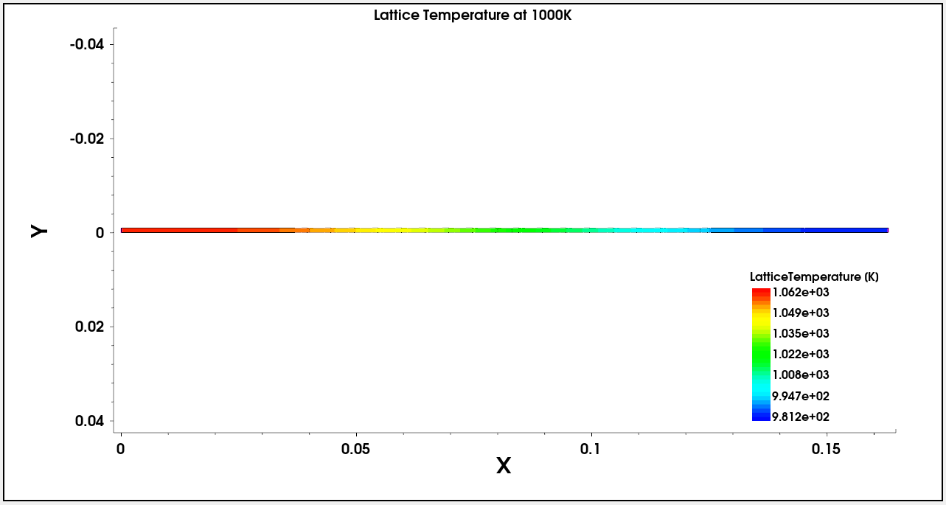
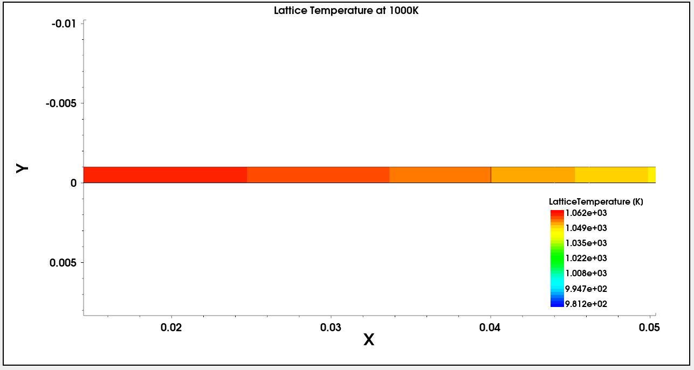
Lattice @1000K
In the case of lattice temperature the value increases in the region of High current density and impact ionization.
This trend shows us a direct relation between temperature and impact ionization, which leads towards higher current density.

Slide 26
Asymmetric Structure
.

Slide 27
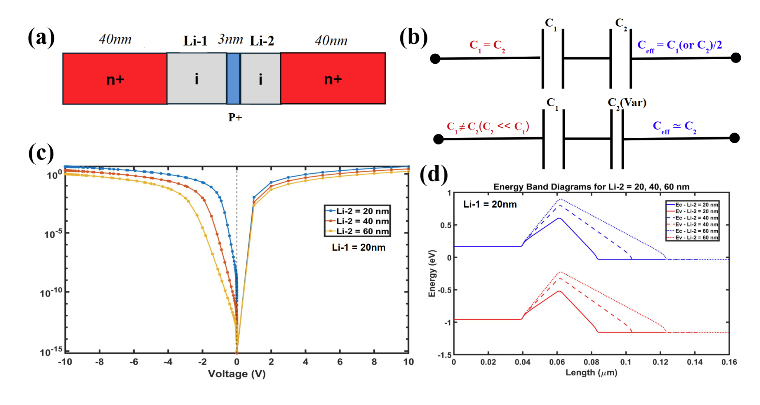
Structural overview and electrical behavior of the asymmetric
NIPIN diode
Asymmetrical Design: Li-1, Li-2 regions with p⁺ center enable punch-through.
Capacitance Model: C_eff ≈ C2 in asymmetric case (C1 ≫ C2).
IV Trends: Higher Li-2 lowers forward current and delays breakdown.
Band Diagram: Increasing Li-2 flattens barrier, reducing electric field.

Slide 28
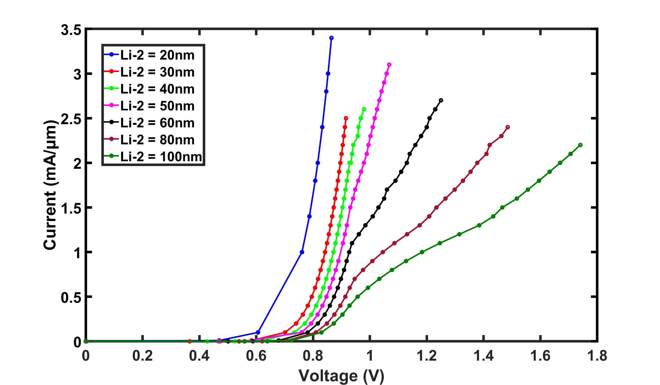
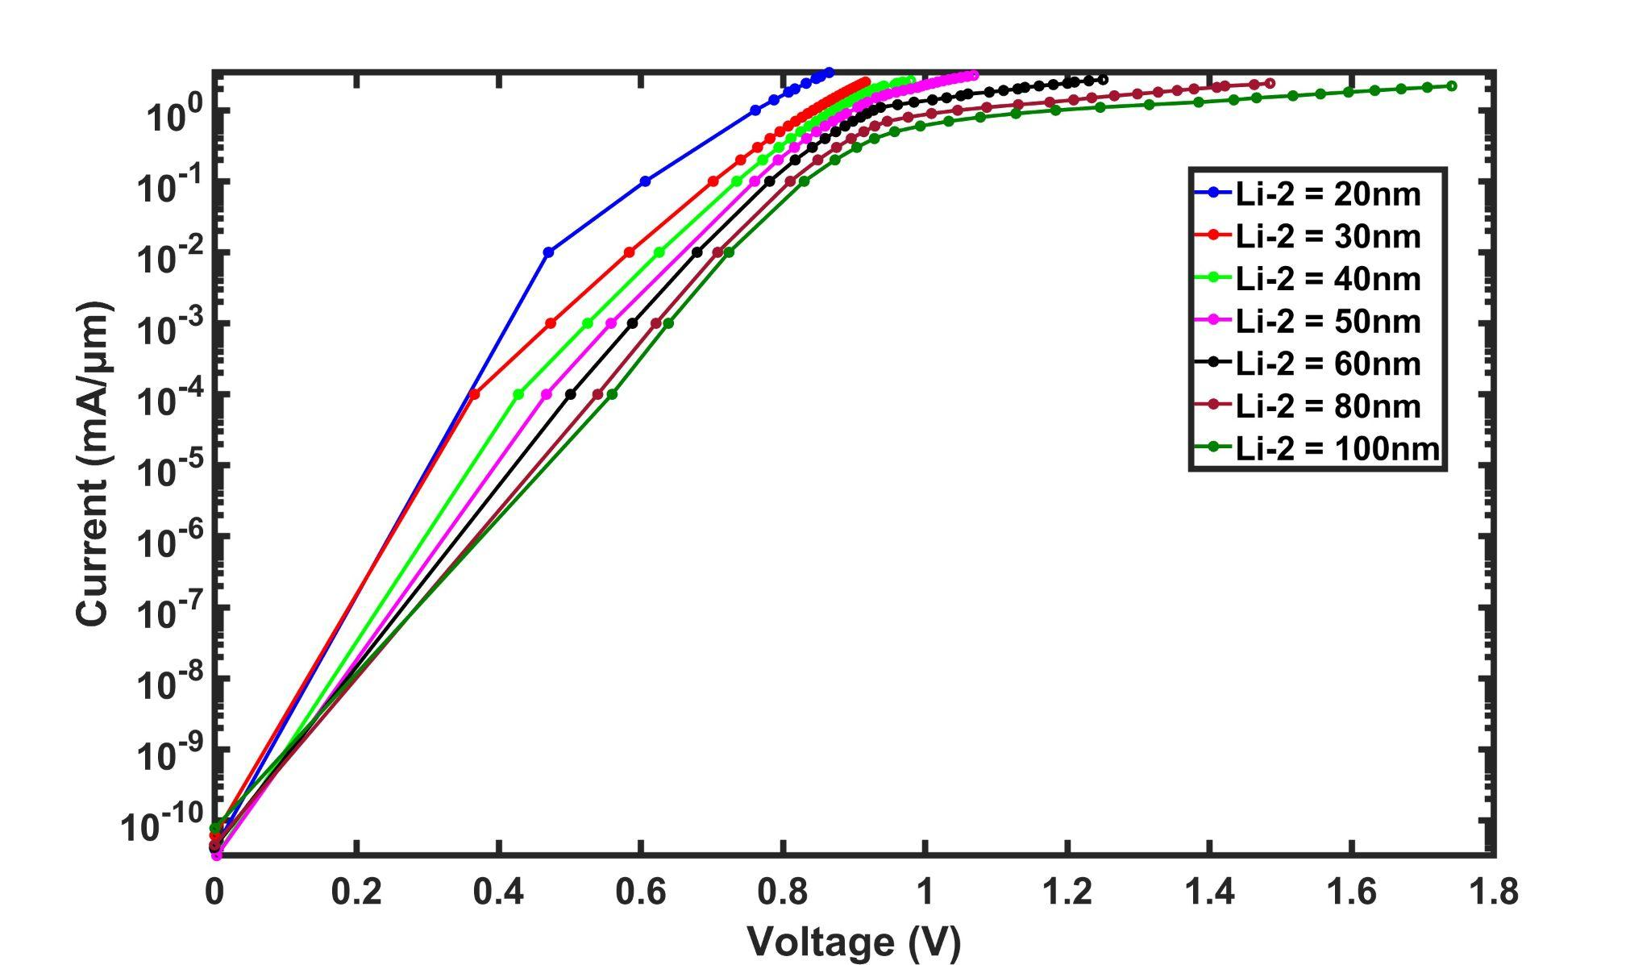
Lᵢ Variation
As L_{i} increases Barrier Height Increases due to which the V_{br} of the diode increases

Slide 29
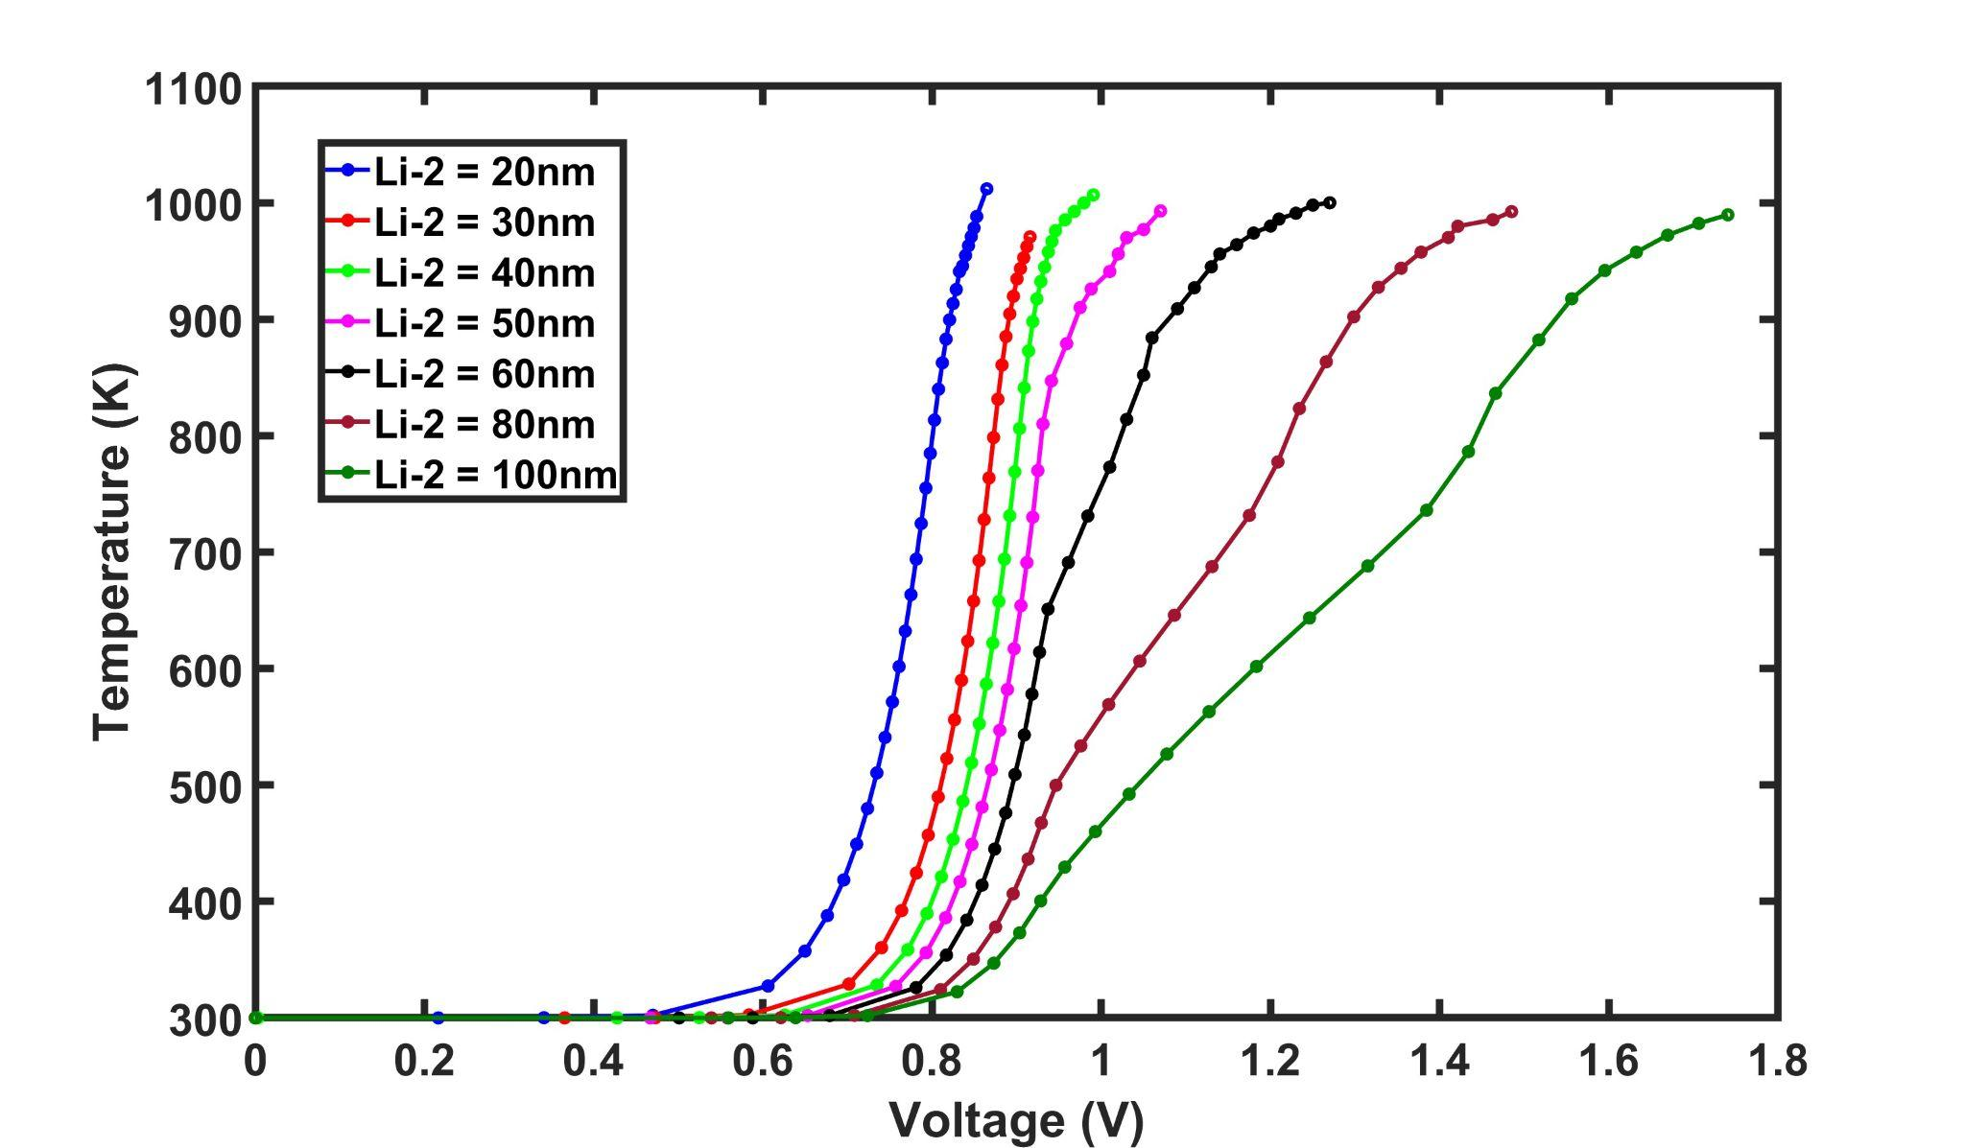
TEMP-Lᵢ Variation
TLP curves for different Li-2 values, showing a shift in breakdown voltage and increase in the temperature with increasing intrinsic length.

Slide 30
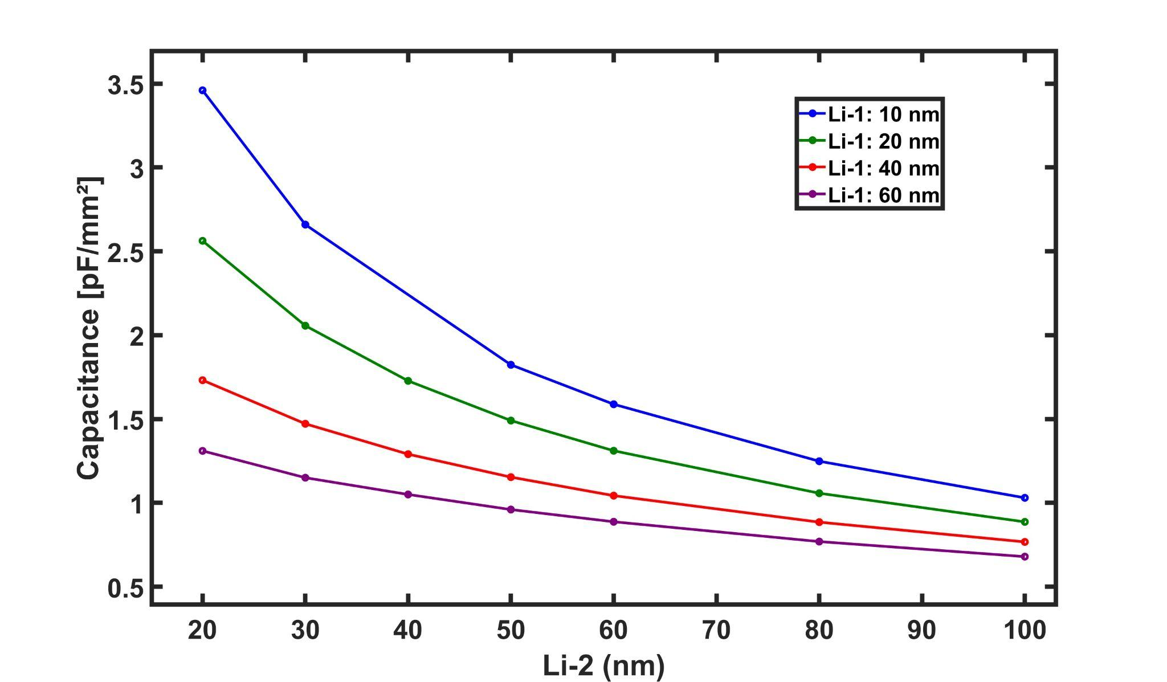
Capacitance Variation
Capacitance decreases consistently with increasing Li-2, while lower Li-1 values exhibit higher overall capacitance.

Slide 31
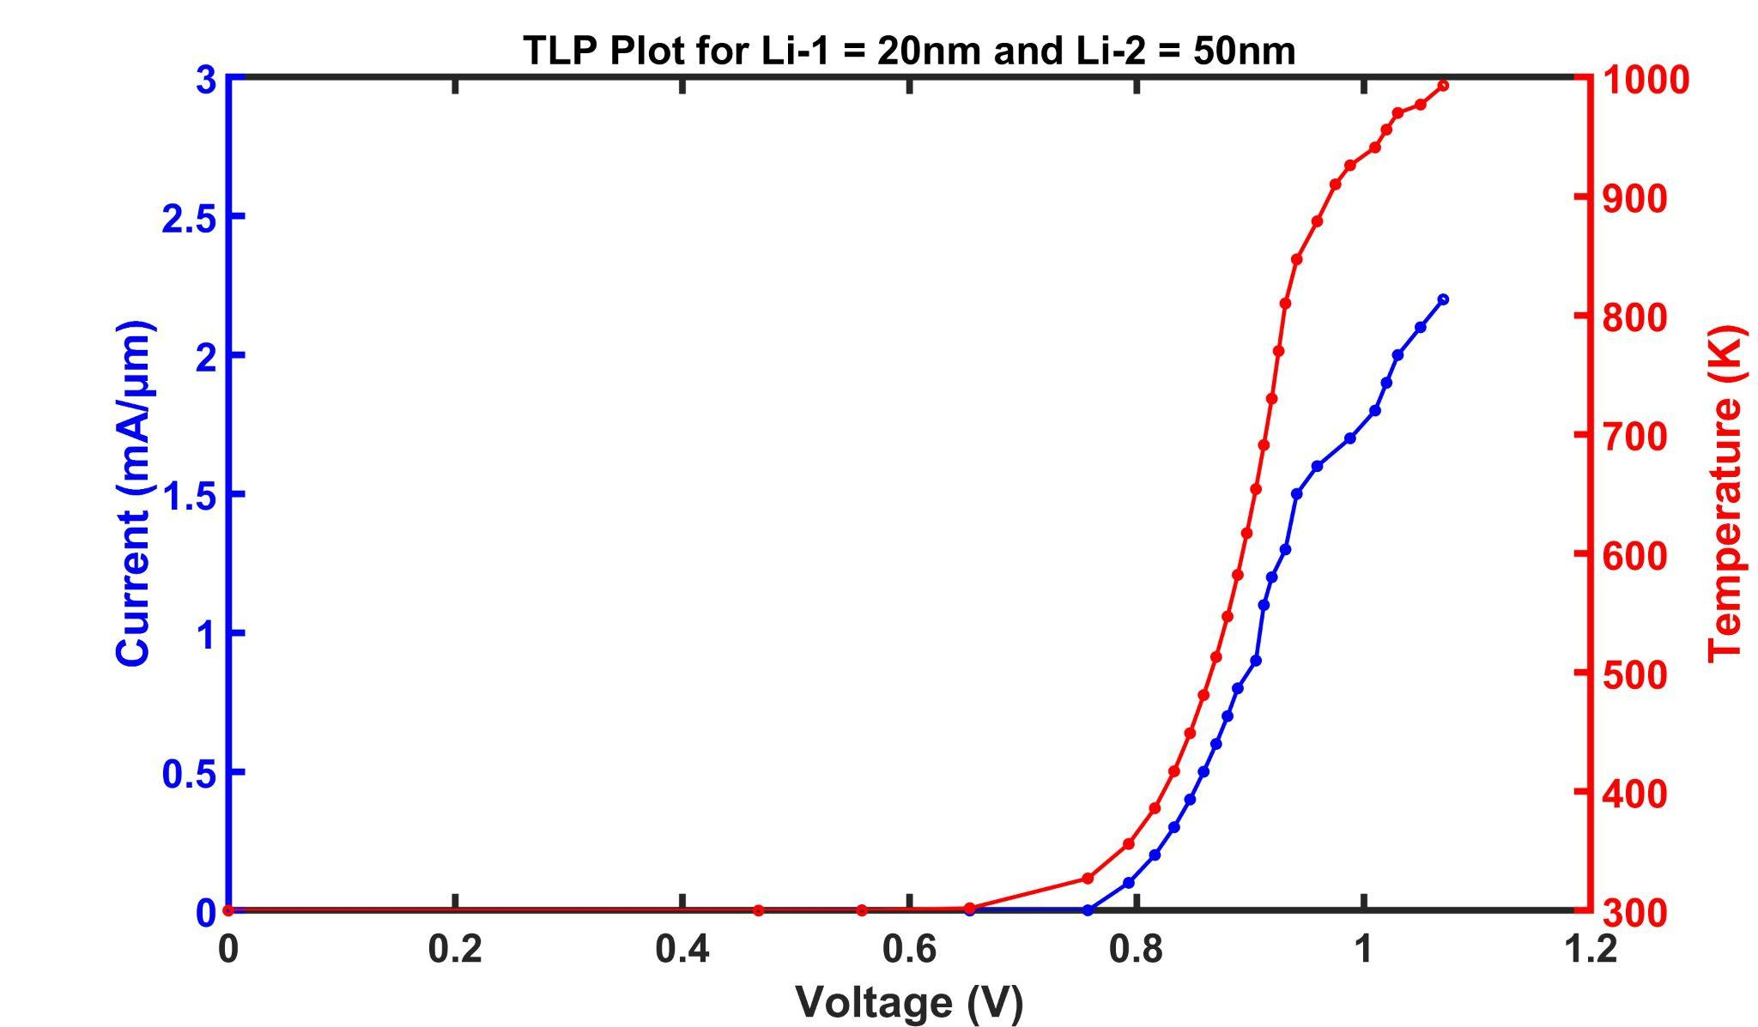
Conclusion
The plot shows simulated IV and Temp-V characteristics for the diode with Li-1 = 20nm and Li-2 = 50nm. The structure demonstrates sub-bandgap breakdown near 0.7V with a peak current of 2.2mA/µm at 1000K. The extracted junction capacitance is 1.49pF/mm^2

